Slide 1
The NHS in England
Duncan Burton
Deputy Chief Nursing Officer
NHS England
Notes:
Standard title slide

Slide 2
Our plans to mark NHS75
www.england.nhs.uk/nhsbirthday

Slide 3
The NHS Constitution
Principles that guide the NHS:
The NHS provides a comprehensive service, available to all
Access to NHS services is based on clinical need, not an individual’s ability to pay
The NHS aspires to the highest standards of excellence and professionalism
The patient will be at the heart of everything the NHS does
The NHS works across organisational boundaries
The NHS is committed to providing best value for taxpayers’ money
The NHS is accountable to the public, communities and patients that it serves

Slide 4
The NHS - key facts and figures
The population of England is 57 million – the NHS provides nearly 1.1 million GP appointments every day – over two thirds of these are face to face and approaching 50% are on the same day that the patient called.
In England there are 564 million patient contacts each year [10 contacts for every single person]
100 million outpatient appointments
1.5 million patient interventions every day – over 1000 each minute
7 million inpatient admissions to hospital each year
Around 250,000 cancer referrals a month
1.6 million mental health interventions every month
1,600 babies born every day (1 every 56 secs)
120 million prescriptions issued every month
Notes:
Plain slide with subhead and bullets

Slide 5
How the NHS in England is structured

Slide 6
NHS in England
Understanding accountabilities and structures in the national health and care system in England | The King's Fund (kingsfund.org.uk)

Slide 8
CBP-7206.pdf
(parliament.uk)

Slide 9
About NHS England

Slide 10
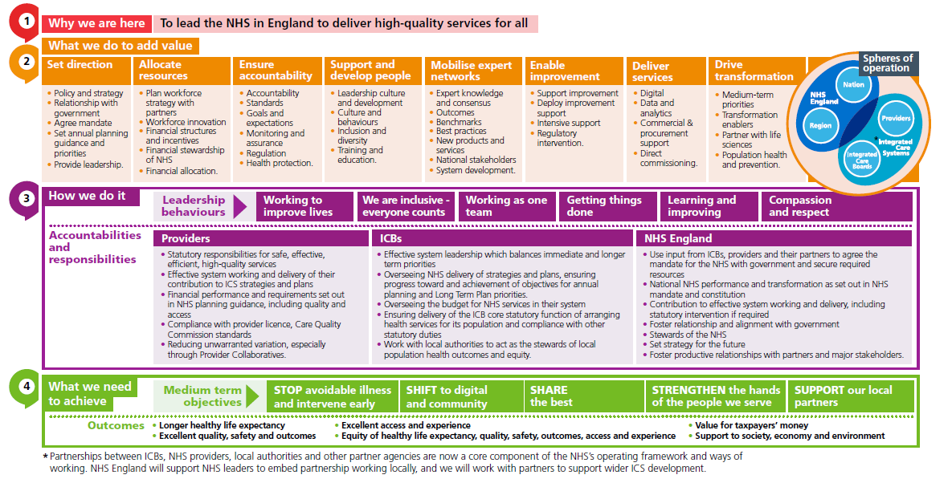
What we do to add value

Slide 11
The role of Integrated Care Boards
To bring the local NHS together to ensure the healthcare needs of their communities are met, and together with local authorities, act as the stewards of local population health outcomes and equity.
To work with providers, local authorities and other partners to create local integrated care strategies and joint five-year forward plans for their system.
To oversee NHS delivery of these strategies and plans including system level delivery of NHS annual planning objectives and NHS Long Term Plan priorities.
To oversee system health budgets and account for NHS system financial allocations.
Notes:
Plain slide with subhead and bullets

Slide 12
The role of providers
To ensure statutory responsibilities are met for the delivery of safe, effective, efficient, high-quality services, both for the here and now and longer term and to reduce unwarranted variation within and across ICSs.
To contribute to effective system working and their role in the delivery of ICS strategies and plans.
To meet the financial and performance requirements set out in NHS planning guidance and to comply with their provider licence and Care Quality Commission (CQC) standards.
Notes:
Plain slide with subhead and bullets

Slide 13
Nursing facts and figures

Slide 14
Key facts and figures
The number of nurses, midwives and nursing associates registered to practise in the UK has grown to a record total of 788,638.
This means the NMC register is now equivalent to 1.2 percent of the estimated UK population.
The number of NHS staff has grown materially in the past decade. Since 2010, there are 55,000 more nurses, health visitors and midwives, with an estimated 2,400 nurses in general practice.
There were a record 52,148 new joiners to the NMC register last year, almost half of whom are internationally educated.
Today, our NHS is more diverse than at any other point in its history and represents more than 200 nationalities.
We now have more than 3,700 qualified Professional Nurse Advocates across England providing restorative supervision to their colleagues and teams, in nursing and beyond.
Notes:
Plain slide with subhead and bullets

Slide 15
The Long Term Workforce Plan
Purpose of LTWP
Sets out NHSE’s assessment of workforce needs over 15 years, centred around three main areas:
1. Recruit
2. Retain existing talent
3. Reform
Intended to be the start of an ongoing programme of work that becomes an established part of how the NHS plans for, and delivers, its services for patients and the public.
With full implementation of the LTWP, it would result in an expansion of the NHS permanent workforce from 1.4 million in 2021/22 to 2.2-2.3 million in 2036/37.

Slide 16
LTWP – Implications for Nursing
By the end of 2036/37, with full implementation, there will be at least an additional 170,000 nurses in the NHS workforce
Recruit
Increasing nurse training places by up to 80%
Increase the number of nurses trained through the apprenticeship route from 9% to 28% by 2031/32.
Increasing education and clinical placement capacity
Expand the number of enhanced and advanced practitioners and new roles
Retain
Building on the high impact areas for retention including flexibility and modernising the NHS Pension Scheme.
Commitment to ongoing national funding for continuing professional development for nurses, midwives and allied health professionals.
Encourage NHS organisations to undertake cultural reviews on a regular basis to improve working environments.
Reform
With the NMC explore further changes to nursing degrees
HEIs to adopt the NMC’s new standard - up to 600 hours of practice learning to be undertaken via simulation.
Evaluation of blended learning programmes and embedding digital technology in training pathways.
Support the expansion of Trusts adopting the National Preceptorship Framework for newly registered nurses, NAs and midwives.

Slide 17
NHS Nurses and Health Visitors
NHS Hospital & Community Health Service (HCHS) monthly workforce statistics: HCHS staff for England by main staff groups - Full Time Equivalent
Data description
There are currently a reported 334,132 FTE registered Nurses and Health Visitors employed within NHS Hospital & Community Health Services in England.
This represents an increase of c.12,500 FTE over the past 12 months, net annual workforce growth of +3.9%. This compares to an average of +3.5% over the previous 3 years.
Despite this increase, there are still a reported c.37,000 Nursing vacancies across the country in March 2023, a vacancy rate 9.9%.
However, this does represent a decrease from a reported vacancy rate of 10.1% in March 2022 and a peak of 11.6% on March 2019.

Slide 18
NHS Midwives
NHS Hospital & Community Health Service (HCHS) monthly workforce statistics: HCHS staff for England by main staff groups - Full Time Equivalent
Data description
There are currently a reported 22,308 FTE registered Midwives employed within NHS Hospital & Community Health Services in England.
This represents an increase of 281 FTE over the past 12 months, net annual workforce growth of +1.3%. This compares to an average of +0.3% over the previous 3 years.
Despite this increase, there are still a reported c.2,700 Midwife vacancies across the country in March 2023, a vacancy rate of 10.3%.
However, this does represent a decrease from a peak of 13.1% (c.3,400 vacancies) reported in August 2022.

Slide 19
NQB Effective Staffing
CNO Safer Staffing Fellowship/MSc in Healthcare workforce planning, delivery and governance
Commissioned by National Quality Board (NQB), led by Nursing Directorate with wide stakeholder involvement
Programme builds upon current safe staffing policy and guidance such as NQB expectations (2016), “Developing Workforce Safeguards” (NHSI 2018) and CQC “Well Led” criteria
Currently reviewing and refresh the existing safe staffing resources on:
NHS England » Safer staffing: nursing and midwifery

Slide 20
National priorities for nursing retention
Toolkit- supporting organisations to assess themselves against a bundle of interventions aligned to the People Promise and use the outcome of this to develop a high quality retention improvement plan.
Early Career
Ensuring supportive transition and onboarding beyond the first 6 months is critical. The quality of preceptorship nationally is variable and requires enhancement. Our focus is in two areas.
national gold standard preceptorship framework and credentialing programme
3
Later Career
Other Areas of Focus
Mental Health Nursing (Practice Nurse Educators & Professional Nurse Advocates)
Community Nursing
Primary Care Nursing
International Recruitment (‘We are the NHS’ IR Campaign call to action)
Health Care Support Workers
The nursing and midwifery retention self assessment toolkit brings together all the evidence available globally and nationally related to the bundle of interventions that are likely to have the most impact on job satisfaction and retention of nurses, aligned to the People Promise
We are supporting nurses to work for longer and in more flexible ways if they wish to (e.g., retire and return). Our work in this area has focussed on pensions, flexible working, menopause and wellbeing
Outputs include menopause guidance, policy and e-learning; pension guidance and seminars, a suite of Legacy mentoring resources, flexible working and other opportunities contained within the new retention guide.
These priorities are informed by the evidence on retention and two key facts related to nurse retention:
A. We have three key risk points related to job satisfaction and retention of nurses: Early career; their experience at work; and later career
B. Single interventions have limited efficacy – so a bundle approach is needed to deliver sustained gains
NHS England » Looking After Our People – Retention hub

Slide 21
Nursing International Recruitment Programme Overview
Programme aims
Develop an ethical and sustainable programme that supports a step change in International Recruitment across the NHS and to ensure nurses are fully supported throughout the process.
Aim: recruit c.80k international nurses Sep 2019 – Mar 2024
Programme objectives
DHSC Led
DHSC & NHSE Led
NHSE Led
3. Consolidate and build on the recent increases in International Recruitment, developing the NHS as the ‘destination of choice’ for internationally trained nurses
4. Support new, innovative, and collaborative approaches to trust/system led international recruitment to reduce duplication and competition
5. Ensure all international recruitment the NHS conducts is “nurse centred” and ensure effective induction, pastoral and professional support
6. Support all trusts to access the international market for nurses
1. Open new supply routes into the NHS and ensure ethical recruitment
2. Maximise the pool of nurses who meet the standards of the NMC
Workstreams (supporting one or more objective)
Ethical recruitment
Broadening supply
Financial Incentives
Universal Support Offer
INMAs
Pastoral Care Quality Award
Accelerated Development and Transformation Fund
Accommodation and Integration
English language
Refugee Programme
OSCE assurance
Supporting IR in specialist roles
Cross cutting workstreams supporting all objectives
Direct Support Offer: Data Collection, Diagnostic Support, Regional Funding
NHS England » Nursing workforce – International recruitment

Slide 22
International Nursing and Midwifery Associations (INMAs)
International recruitment | NHS Employers

Slide 23
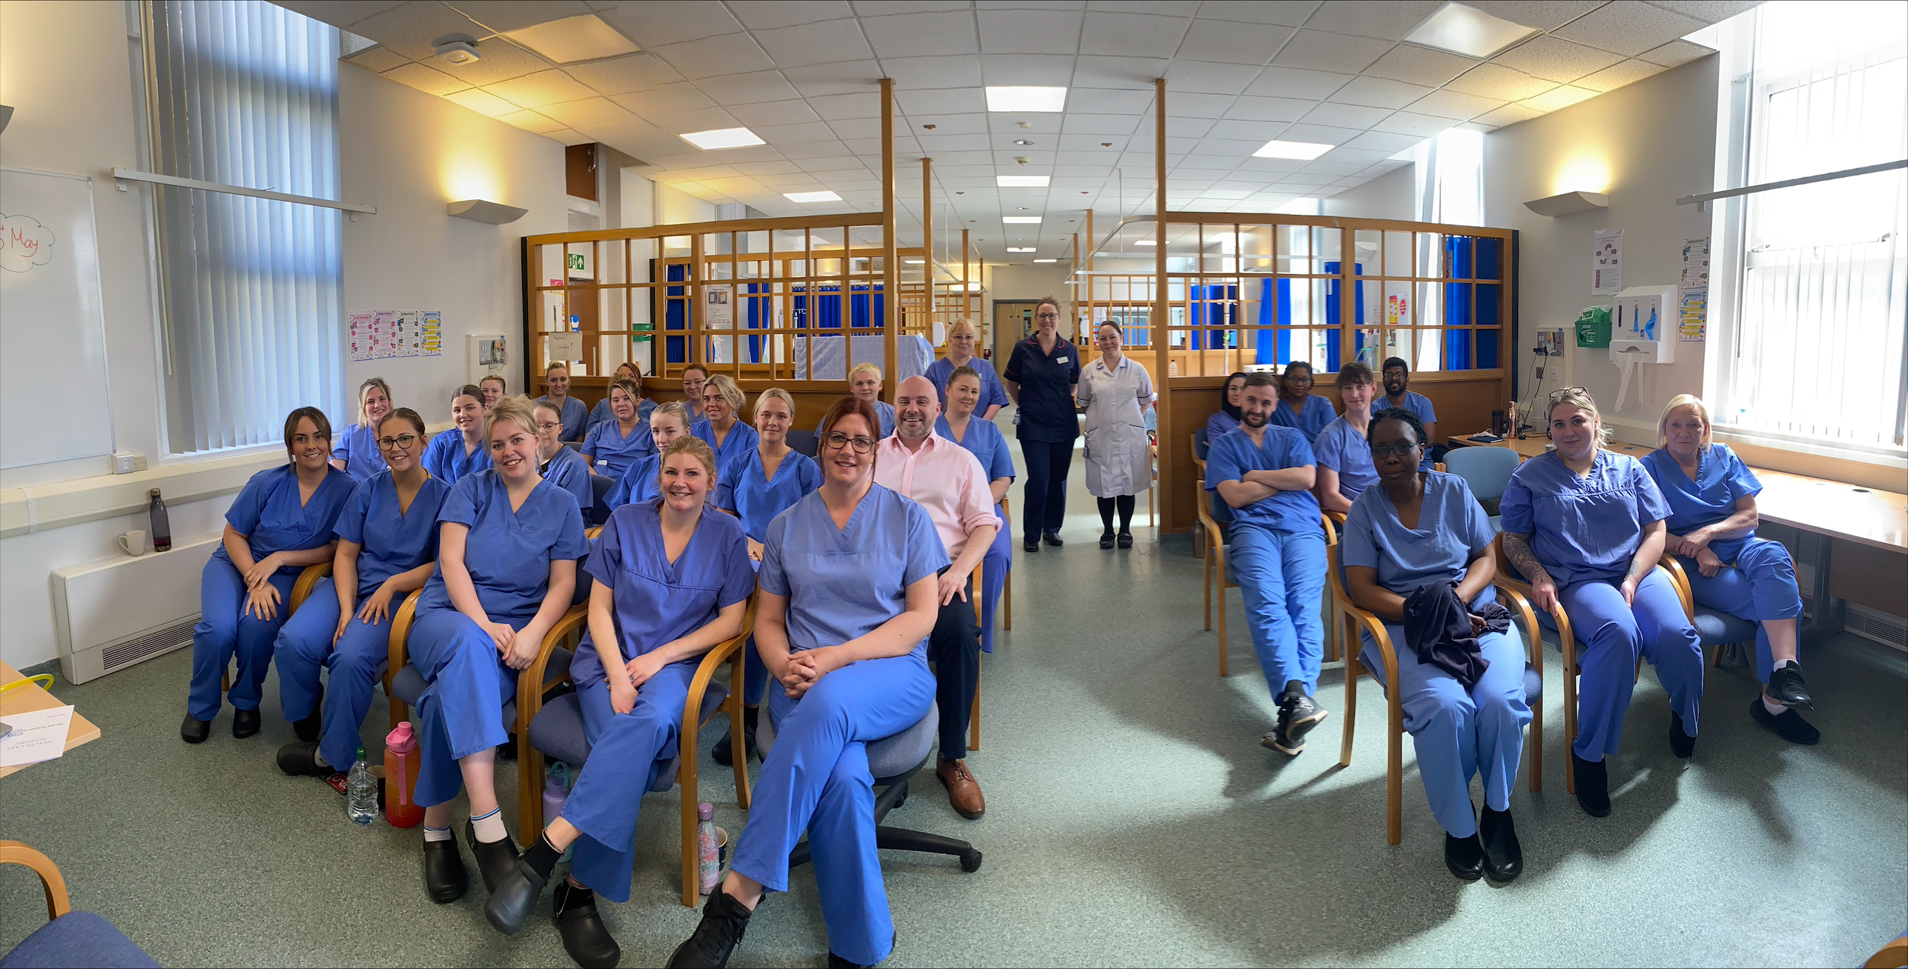
NHS Support Worker Programme
NHS England » Healthcare support worker programme

Slide 24
There are 11k more HCSWs employed in the NHS since Jan 2020, totalling c.156.6k, the highest observed
Data description
Data source: NHS workforce statistics - NHS Digital
Workforce numbers include Nursing support staff at staffing levels; Nursing Assistant / Auxiliary, Healthcare Assistant, Support Worker
Proxy data in place between March – October 2020 where staff supporting (student nurses/returnees) during the Covid pandemic were temporarily coded as healthcare support workers within trust systems
Trusts have reported on average c.3,000 healthcare support workers joining the workforce each month throughout FY22/23
Of the c.35,800 joiners in FY22/23, 46% were reported to be new to healthcare
At February 2023 (most recent published data), there were 156,602 FTE staff in post, this compares to the previous workforce peak at March 2021 of 155,649 FTE

Slide 25
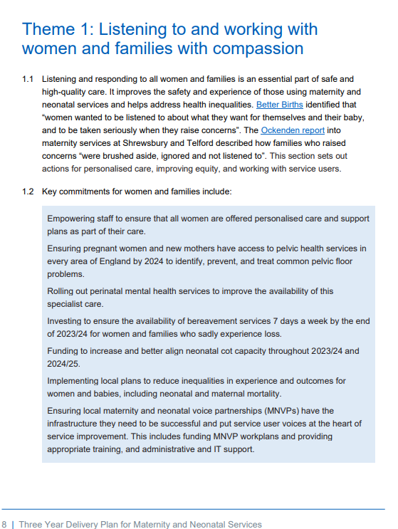
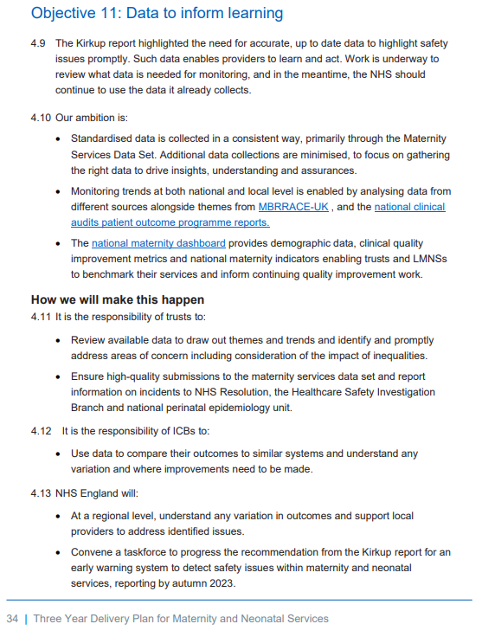
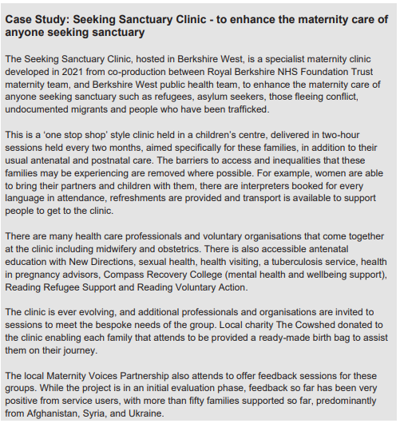
NHS England » Three year delivery plan for maternity and neonatal services

Slide 26
The Three Year Maternity & Neonatal Delivery Plan
The plan has four themes and twelve objectives.
1
Listening to and working with women and families with compassion
3
Developing and sustaining a culture of safety, learning, and support
Care that is personalised
Improve equity for mothers and babies
Work with service users to improve care
Develop a positive safety culture
Learning and improving
Support and oversight
2
Growing, retaining, and supporting our workforce
4
Standards and structures that underpin safer, more personalised, and more equitable care
Grow our workforce
Value and retain our workforce
Invest in skills
Standards to ensure best practice
Data to inform learning
Make better use of digital technology in maternity and neonatal services

Slide 27
The role of the Chief Nursing Officer for England

Slide 28
Dame Ruth May is the Chief Nursing Officer for England and executive director at NHS England.
She provides clinical and professional leadership for all nurses and midwives in England, and expert clinical and workforce advice to the Government, Department of Health and Social Care and the Board of NHS England.

Slide 29
Nursing Directorate Vision
NHSE Purpose: to lead the NHS in England to deliver high-quality services for all
We will achieve this purpose by:
Enabling local systems and providers to improve the health of their people and patients, and reduce health inequalities
Making the NHS a great place to work, where our people can make a difference and achieve their potential
Working collaboratively to ensure our healthcare workforce has the right knowledge, skills, values, and behaviours, to deliver accessible, compassionate care
Optimising the use of digital technology, research and innovation
Delivering value for money
Nursing Directorate Vision Statement
To provide professional leadership to the Nursing and Midwifery professions and on volunteering, setting strategic direction, national priority and policies to drive the delivery of high quality and safe care. Ensure that the nursing and midwifery voice is integral to national health and social care policy and strategy; and, working alongside the medical directorate, that clinical leadership is at the heart of NHS England.​
Working together with patients, carers and the public to transform healthcare and improve experience and outcomes for all.
Aim 1
To provide clinical and professional leadership and advice, setting national policy and strategic direction in relation to the portfolio and statutory duties. Ensure synergy with the NHS regional teams, Public Health, the Chief Nurse of Social Care and CNOs of the devolved nations.
Aim 2
To support the Chief Nursing Officer in the discharge of their duties as the Head of Profession for nursing and midwifery in England and the most senior advisor to government on nursing and midwifery issues.
Aim 3
Provide clinical and professional advice across NHSE to ensure the clinical voice is at the centre of national strategy and decision making and national policy is reflective of the views and needs of nursing and midwifery.
Aim 4
Provide nursing and midwifery leadership in quality and innovation matters across the NHS in England and care systems.​
Aim 5
To work in partnership with people and communities, carers, volunteers and the VCSE sector to improve quality and outcomes​
Aim 6
To help promote equality and diversity in Experience of Care and outcomes and narrow the gaps between population groups. ​

Slide 30
CNO Directorate NHS England
Nursing directorate
Chief of Staff
Professional & System Leadership
Quality, Sustainability
& Innovation
Policy & Strategy
Midwifery
Clinical Delivery
People and Communities
Private Office
Safeguarding
Quality Strategy, Leadership and Governance
Policy and Strategy
Maternity Safety & Quality Improvement
Infection Prevention and Control
Insight and Voice
Operations (Business & Portfolio)
Nursing Professional Development
Service Delivery
Transformation and Resilience
Professional strategy and regulation
Leadership & Professional Matters
Children and Young People
Experience and Partnerships (inc. Volunteering)
Nursing Research
Women’s Health and Wellbeing
Midwifery Research
Nursing Workforce policy
Equalities and Involvement (inc LGBT Health)
Clinical Nursing Voice
Community & Primary Care
Mental Health
Learning disabilities
Patient Safety and
Improvement
Maternity & Neonatal
Sustainability and Innovation

Slide 31
CNO Strategy - Strategic context
New professional strategy that will set out the direction of travel and ambitions for nursing, midwifery and nursing associate professions over the next 3-5 years
Developed in the context of other key strategic documents and not intended to duplicate the work of these documents including the NHS Long Term Plan, Long Term Workforce Plan, DHSC Major Conditions review and emerging plans for the wider health and care system
The strategy will cover
nurses, midwives and nursing associates
all health and care settings
all stages of career

Slide 32
End slide

Slide 33
Key plans and guidance
The NHS Long Term Plan
NHS England operating framework
NHS operational planning and contracting guidance
NHS Long Term Workforce Plan
NHS equality, diversity and inclusion (EDI) improvement plan
Delivery plan for recovering urgent and emergency care services
Delivery plan for recovering access to primary care
Visit: www.england.nhs.uk
Notes:
Plain slide with subhead and bullets

