Slide 1
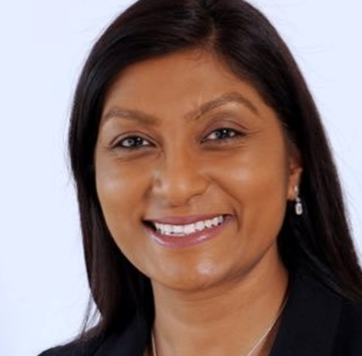
Sue Tranka CNO Wales
Study Background
Bio
Chief Nursing Officer for Wales and Nurse Director of NHS Wales, having taken up post in 2021. She was formerly the Deputy Chief Nursing Officer at NHS England and Improvement. She played a key role in the pandemic response, supporting guidance development, implementation, and re-mobilisation of NHS services.
Sue has 30 years of varied experience in nursing and her career has predominantly focused on quality improvement, human factors and safety systems.
She was made an honorary visiting professor by University of Surrey and more recently by Cardiff University.
In October 2020, Sue was listed among the Health Service Journal’s 50 most influential people in health,.
In December 2021 was awarded a fellowship of the Queen’s Nursing Institute.
In September 2022, Sue attended John F. Kennedy School of Government at Harvard University, and awarded a certificate of completion for the ‘Leadership for the 21st century programme’
Leadership scholarship Florence Nightingale Foundation.
Diploma in Nursing, midwifery, community & MH
PGDip- Healthcare practitioner
MSc- Quality improvement
Kings fund: Athena- Women in Leadership
FNF leadership scholarship
RADA
Fellow- QNI
Hon. Prof Cardiff University
Harvard Kennedy School of Government- Certificate in Leadership for 21st century

Slide 2
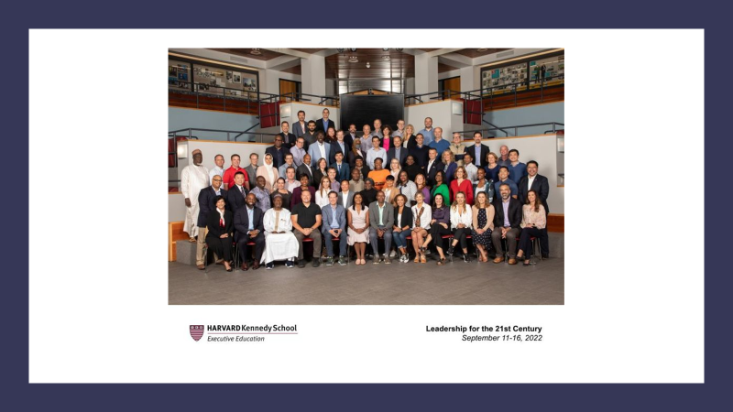
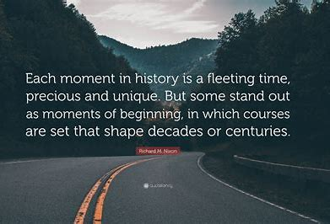
Agenda
Experience
Stand out moments
Impact

Slide 3
Quality Improvement project: Scoping the educational and lived experience of Government Chief Nursing officers Aim: to develop support offer for aspirant and new GCNOs.
Objective-
Scoping exercise of current UK and Europe government CNO’s to understand career development
Identify which opportunities strengthened experience for role
Identify gaps in experience
How to identify a talent pool for government roles in nursing /midwifery
Methodology:
The scope included interviewing the following:
Current UK CNOs for Scotland, Northern Ireland, England,
2 x previous UK CNOs, and Republic of Ireland’s CNO,
European Regional CNO for World Health Organization,
1x Chief Midwifery officer for Wales.
International CNOs
Ideally this will inform and help to expand this work to a second stage; where a full scoping review of current leadership offers across England, Wales and Scotland and devising a bespoke leadership offer to current executive directors of nursing and midwifery, looking to understand the GCNO role and test whether this is the complex and rewarding path they wish to tread.
Phase 3 will involve seeking suitable providers to testa comprehensive offer and deliver such a programme.

Slide 4
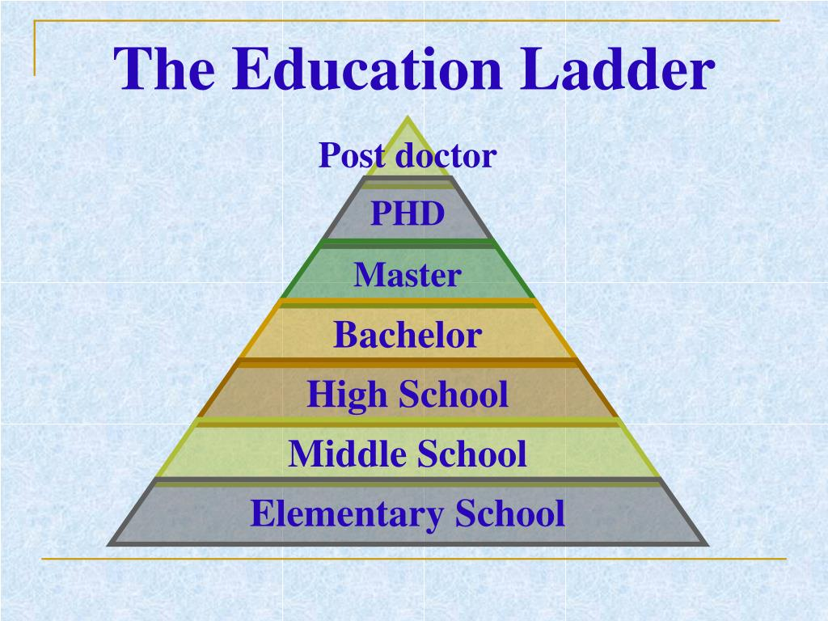
Impact
Research- collaborating with Research organisation in Canada on the value of the government CNO!
Colleagues- Collaboration opportunities
Policy/ org.- Engagement & identifying support offer to address challenges
Service – design and deliver the offer!
develop a clear career pathway that spans educational and leadership education & exposure

Slide 5
Implications for practice/education:
The following key themes have been identified from the leadership scoping work as the key thematic areas for development:
Role of the Senior Civil Servant
Understanding the workings of government (devolved administrations)
Buddying (civil service)
Global & national policy development
Portfolio variation & delivery
Nursing/ Midwifery contribution to healthcare
Most interviewees expressed an interest in creating a ‘Global GCNMO alumni faculty’ that would serve to offer leaders a forum to meet regularly, share information, and offer support and learning from across the globe to other navigating the complexities of policy impact and shared challenges like workforce shortages
Many of the interviewees expressed an interest in developing a clear career pathway that spans educational and leadership education and exposure.
Professional support is critical to ensure that leaders have a safe space to encourage open discussion, seek mentorship that is supported by other nurse leaders that can advise on career pathway.
All expressed that they are no other comprehensive offers or programmes in the UK designed specifically for this requirement. Most felt that creation of a support ‘offer’ would be welcomed.

Slide 6
Acknowledgements I would like to take the time and give space for acknowledgement to the following amazing women leaders who have lifted as they climbed and supported me to undertake and successfully complete the programme.
Professor Greta Westwood
Professor Gemma Stacey
Dame Ruth May
Professor Dame Jill McLeod Clarke
Florence Nightingale Foundation Team
To my sponsor- Dame Ruth May thank you for you unwavering support and belief in me, even when I wanted to turn back- you gave me options and willed me to keep going! For the opportunity to rise higher, and for being such an incredible ally. Thank you for everything.
Jill, you have been a fabulous and amazing mentor, and I have loved every session of sharing insights, listening, learning, and being challenged along my journey. Thank you so very much for the friendship too.
And finally thank you to Greta, Gemma and all at the FNF for this wonderful opportunity, I feel deeply privileged and indebted to you for opening the profession up to a such a wonderful world of possibility.

Slide 7
The way to get started is to quit talking and begin doing.
Walt Disney
Thank you!

